Slide 1
Peer To Peer Video Chat
Deepak T S
Gaomeizhu Qu
Sijia Zhang
Vladimir Pchelin
Notes:
10/10/16
1
1

Slide 2
Description
To build an app where people can video chat with their friends/relatives.
We will be using WebRTC technology.

Slide 3
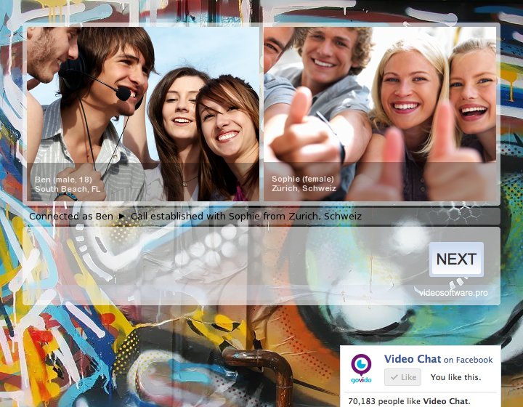
What is WebRTC?
What is WebRTC ?
WebRTC (Web Real-Time Communication):
WebRTC is an open framework for the web that enables Real Time Communications in the browser.
getUserMedia(): capture audio and video.
MediaRecorder: record audio and video.
RTCPeerConnection: stream audio and video between users.
RTCDataChannel: stream data between users.
https://github.com/Yatko/video-chat

Slide 4
Target
One to one video chat
Screen sharing
Sending files

Slide 5
Competition
Skype
Viber
Google Duo
IMO

Slide 6
What is special about our project?
Use both cameras at the same time
We are trying to make usage of other apps possible while on a video call

Slide 7
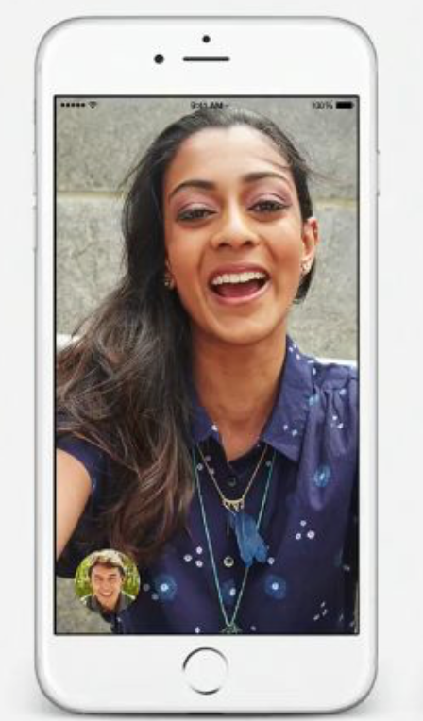
Use case
Log in with mobile phone number /Gmail
Check the list of logged in users
Choose a user to call
Sending invitation to other people
Use both front and back cameras
Sharing screen
Video chat
Multi tasking with other apps
Sending files

Slide 8
Android Application
Programming Language: HTML, JavaScript, Java
Database: MySQL
Distribution platforms: Android Phones
Users: People who know how to use a mobile phone
Beneficiaries: Users

Slide 9
Why Android?
Number of people with Android
Download of Application is easy through Play Store
Ease of access

Slide 10
Technologies
WebRTC
AWS
GitHub

Slide 11
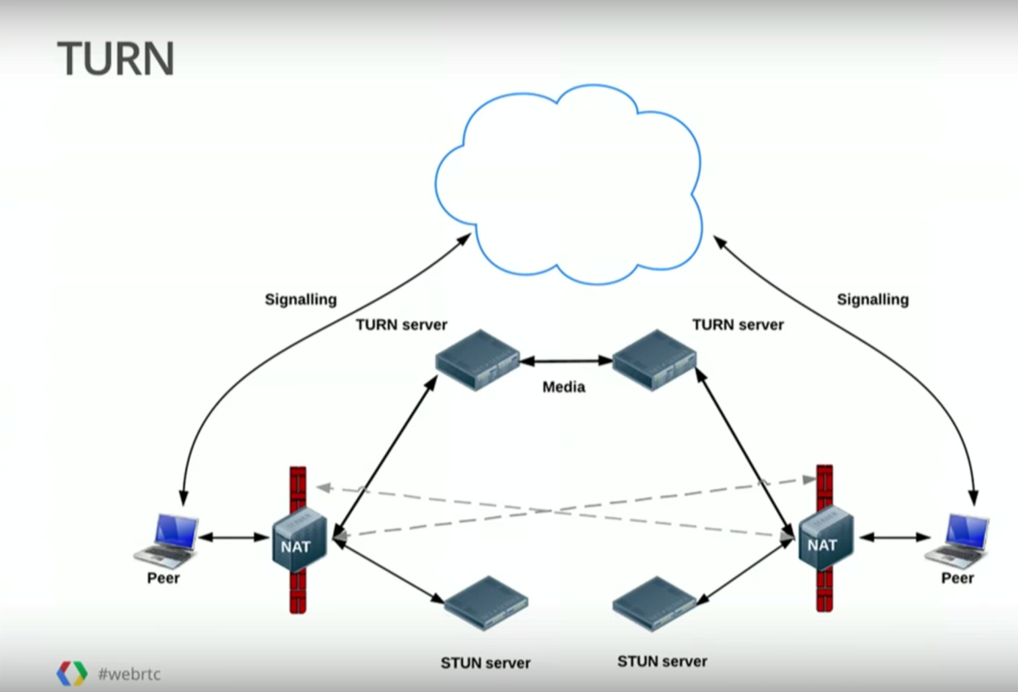
Why WebRTC?
Inbuilt functions for webcam usage
Use of STUN and TURN servers to avoid firewall problems
www.youtube.com/watch?v=p2HzZkd2A40

Slide 12
Plan
Sprint 1: Project introduction
Sprint 2: Figure out the structure of database and WebRTC and learn to use them.
Sprint 3: Combine each part of the technology.
Demo: Debug the entire program.
Done

Slide 13
THANK YOU
*
13

